Slide 1
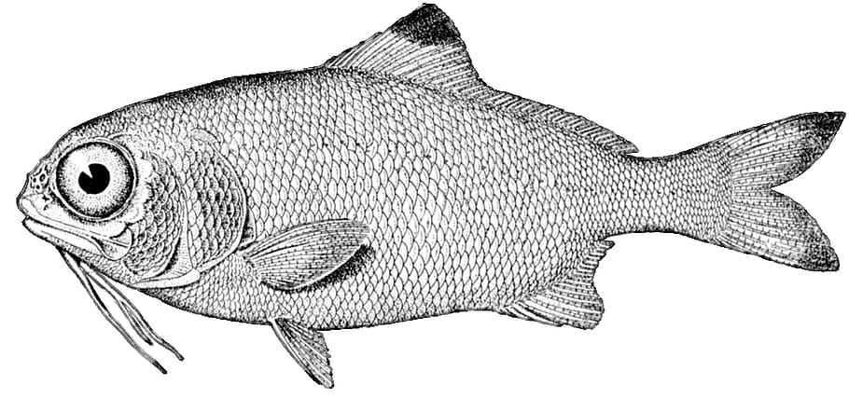
AVA 2024- Mini Challenge 2
ILLEGAL FISHING-Help!
Funda Yildiz Aydin
Sinem Bilge Guler
Mehmet Emre Sahin

Slide 2

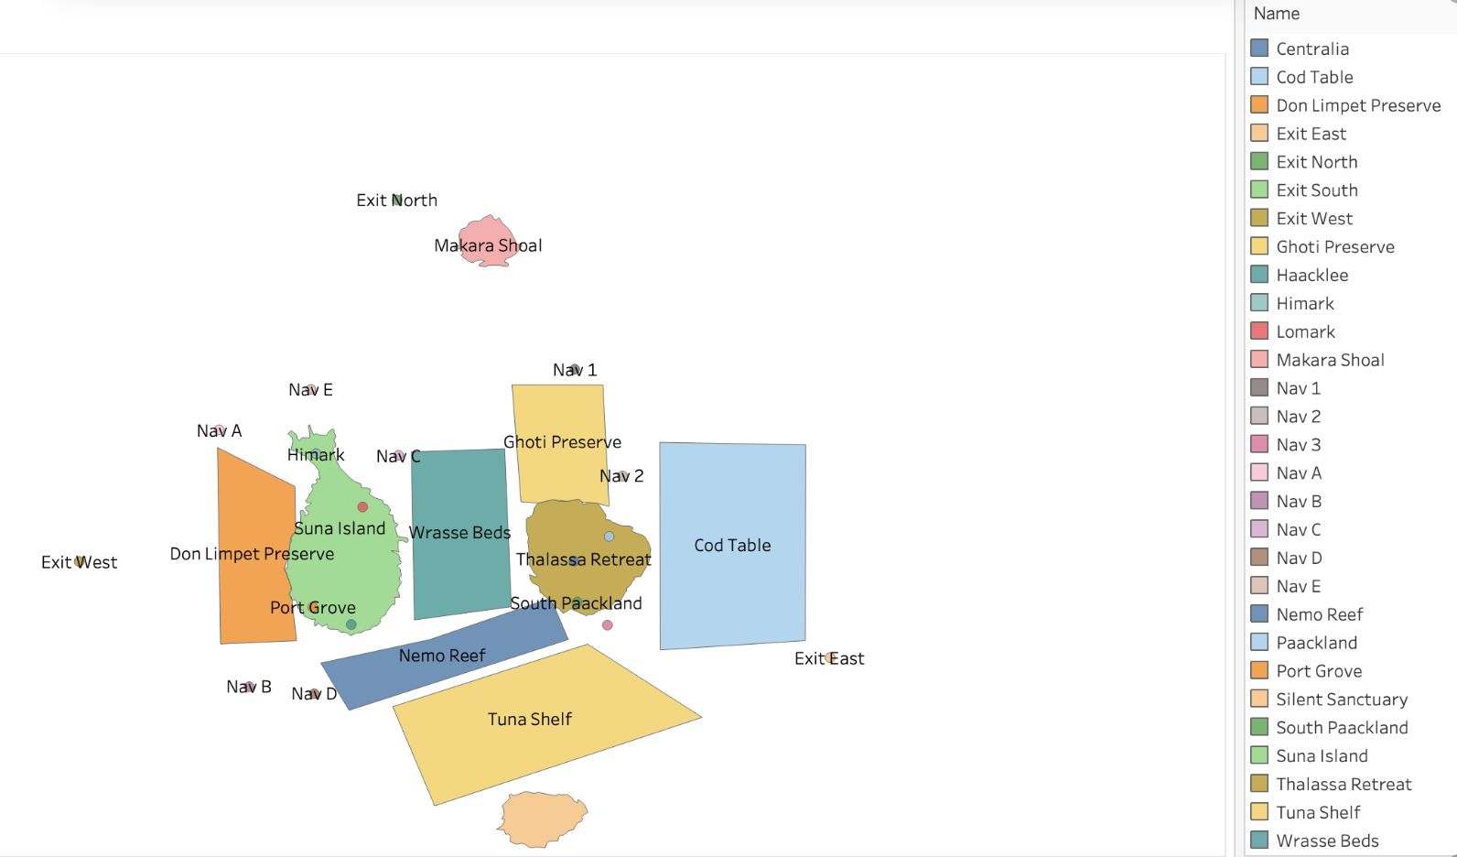
Main Challenges
1- Which vessels deliver which products and when? What are the seasonal trends and anomalies in the port exit records?
2- How do their movement and catch contents compare to other fishing vessels? When and where did SouthSeafood Express Corp vessels perform their illegal fishing? How many different types of suspicious behaviors are observed?
3- 0ther vessels engaging in behaviors similar to SouthSeafoodExpress Corp's illegal activities.
4- How did fishing activity change after SouthSeafood Express Corp was caught? What new behaviors in the Oceanus commercial fishing community are most suspicious and why?
OCEANUS GEOGRAPHY PHOTO

Slide 3
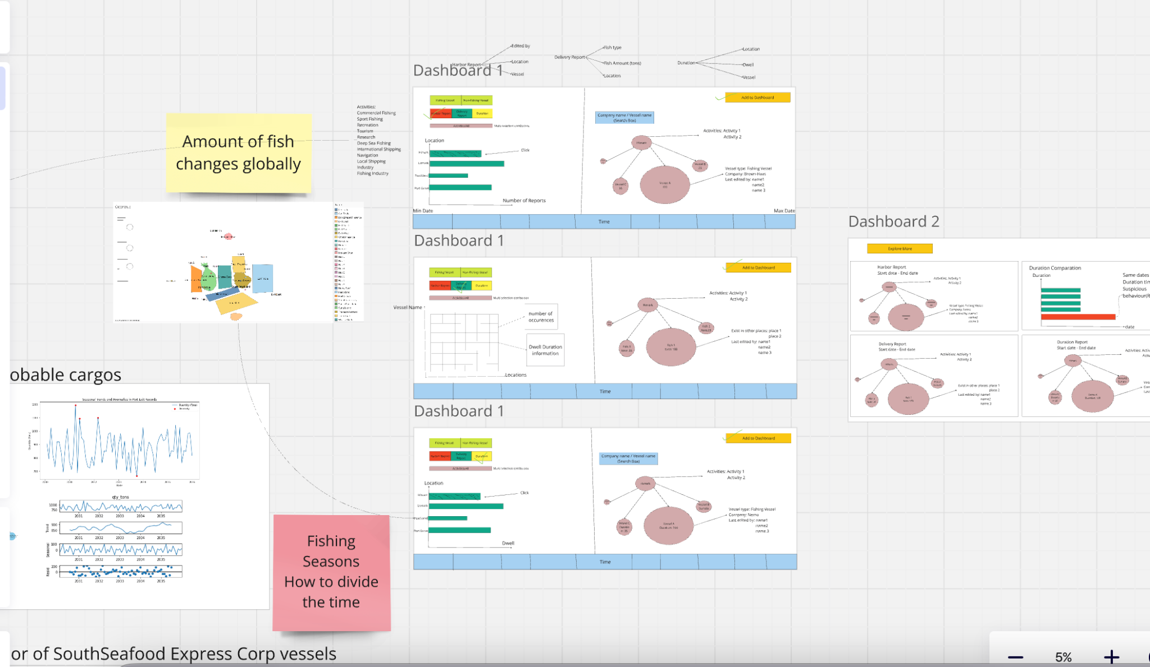
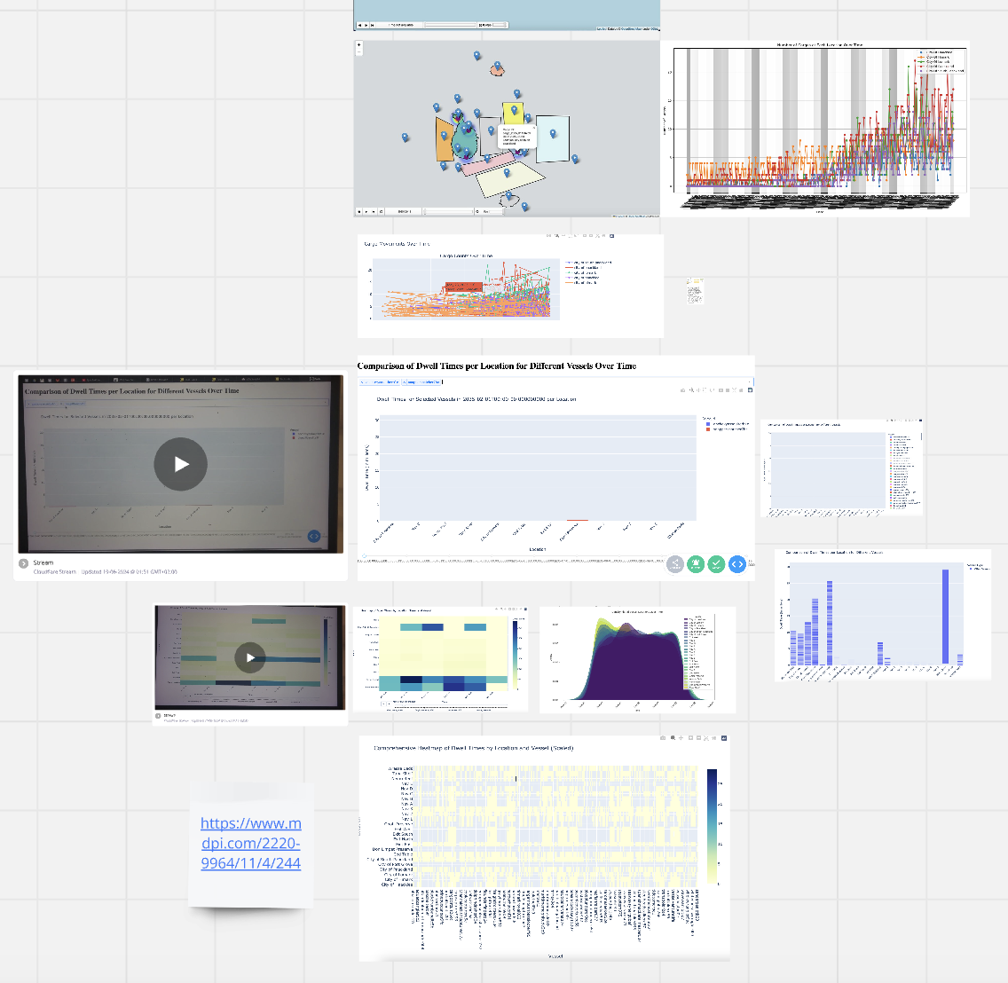
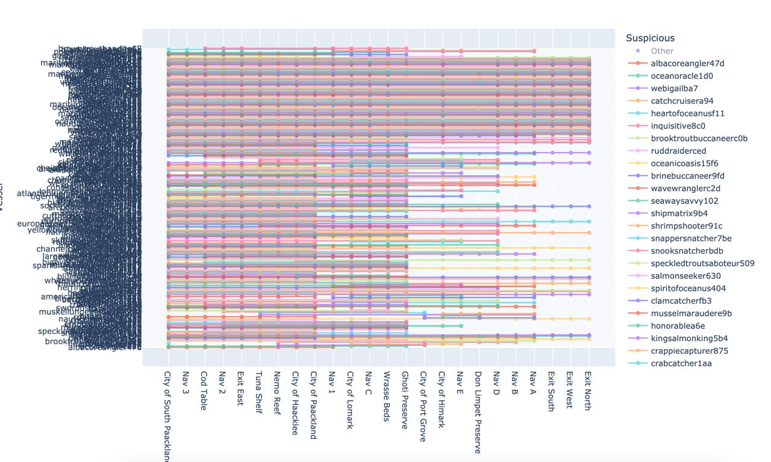
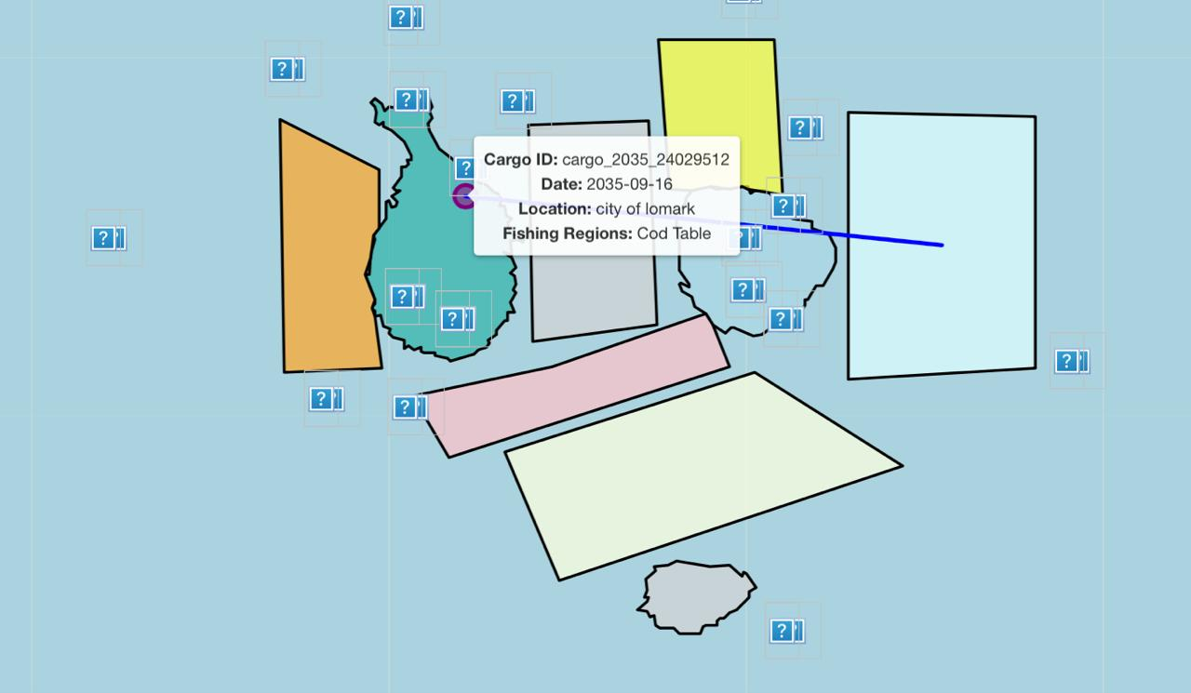
But what to choose for graphs…?

Slide 4
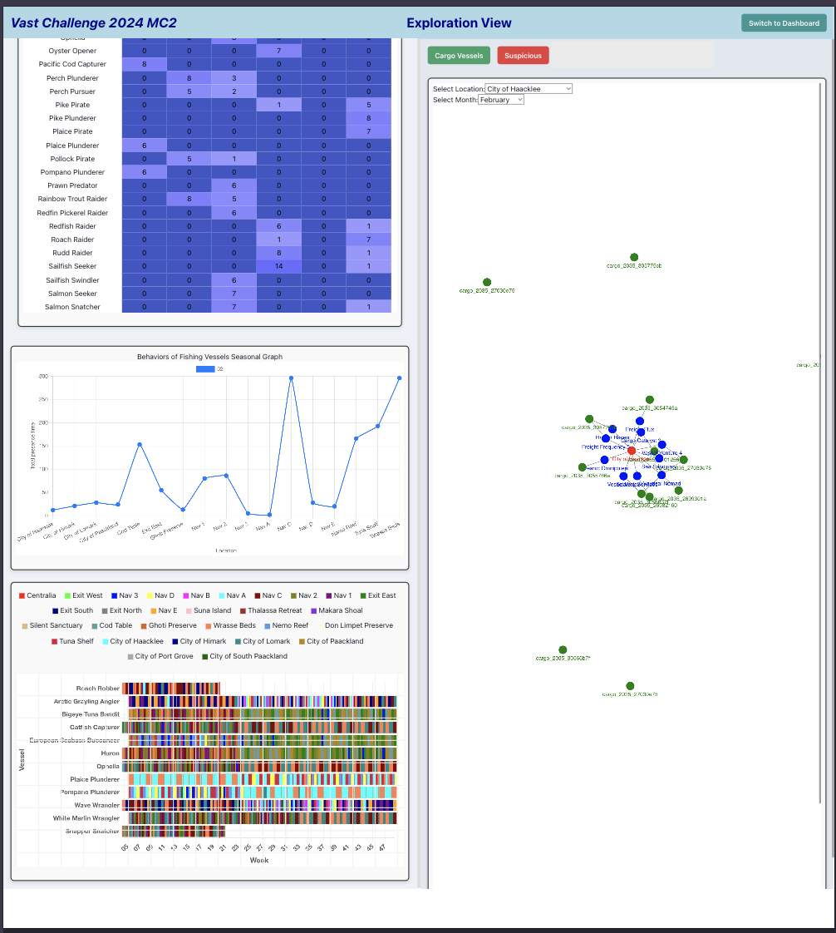
Then we came up with these graphs
5 graphs in total
Heatmap
Network Graphs
Trend graph
Pixel Graph

Slide 5
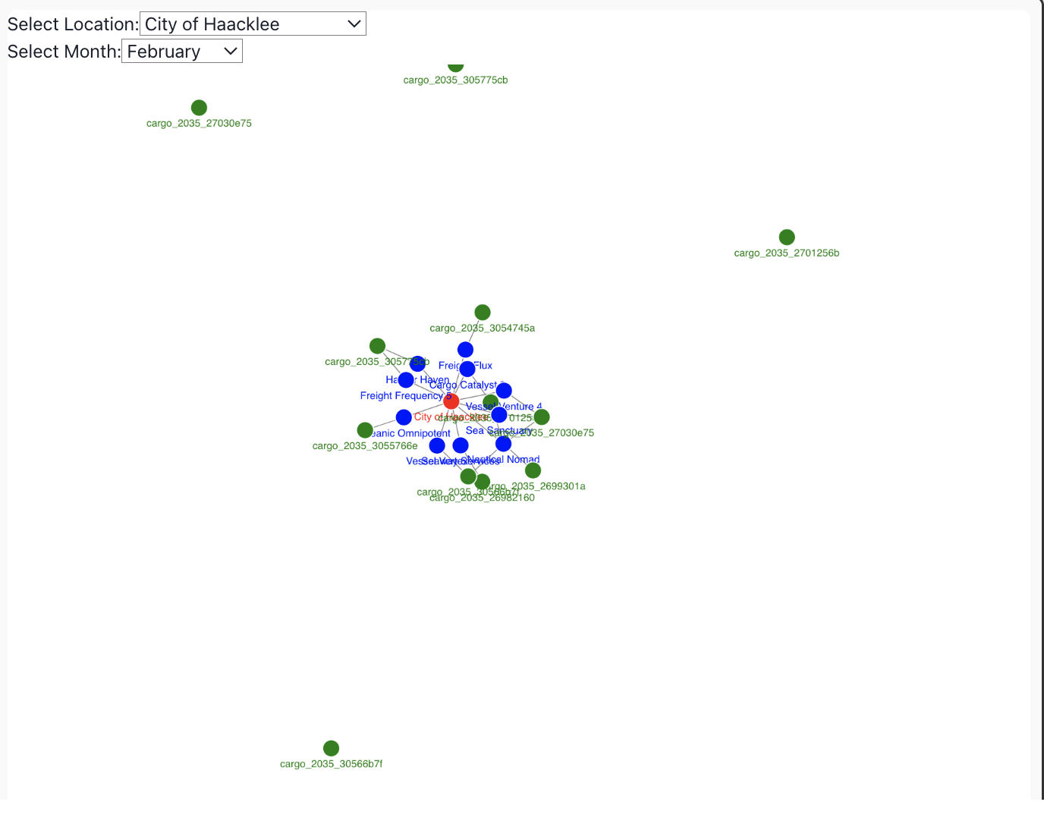
Network Graph - Cargo Vessels
The graph contains 3 different datasets:
1- Transponder Ping
2-Transaction
3- Delivery Report
Matching vessels with their probable Cargos

Slide 6
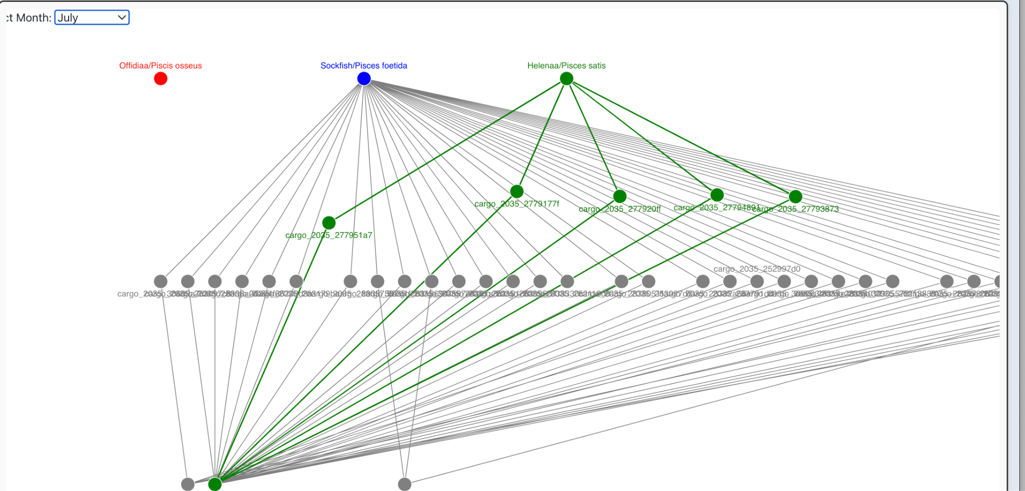
Network Graph- Suspicious
The graph contains 2 different datasets:
1- Delivery Report
2- Transaction
Goal: To show the cargos that carried illegal fishes to the cities. Illegal fishing detection

Slide 7
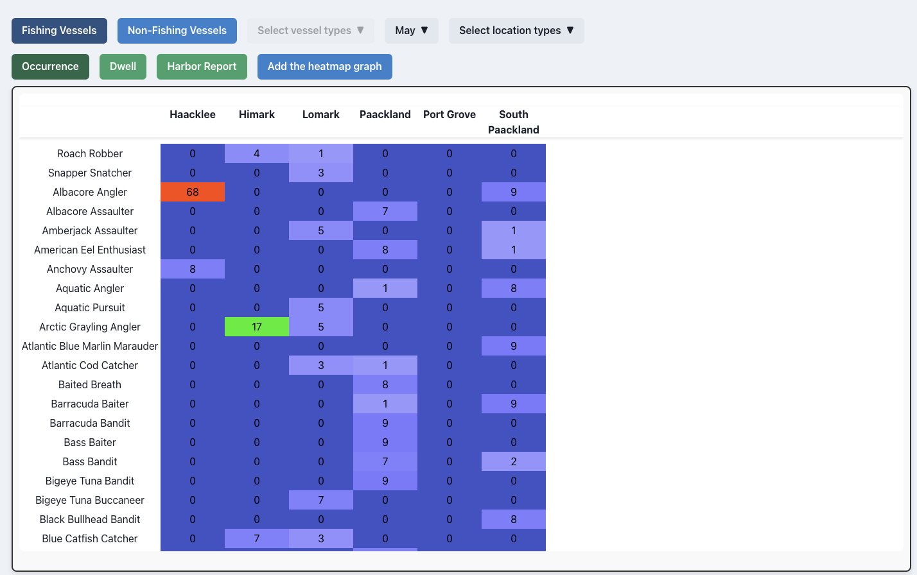
Heatmap Graph
The graph contains 2 different datasets:
1- Transponder Ping
2- Harbor Report

Slide 8
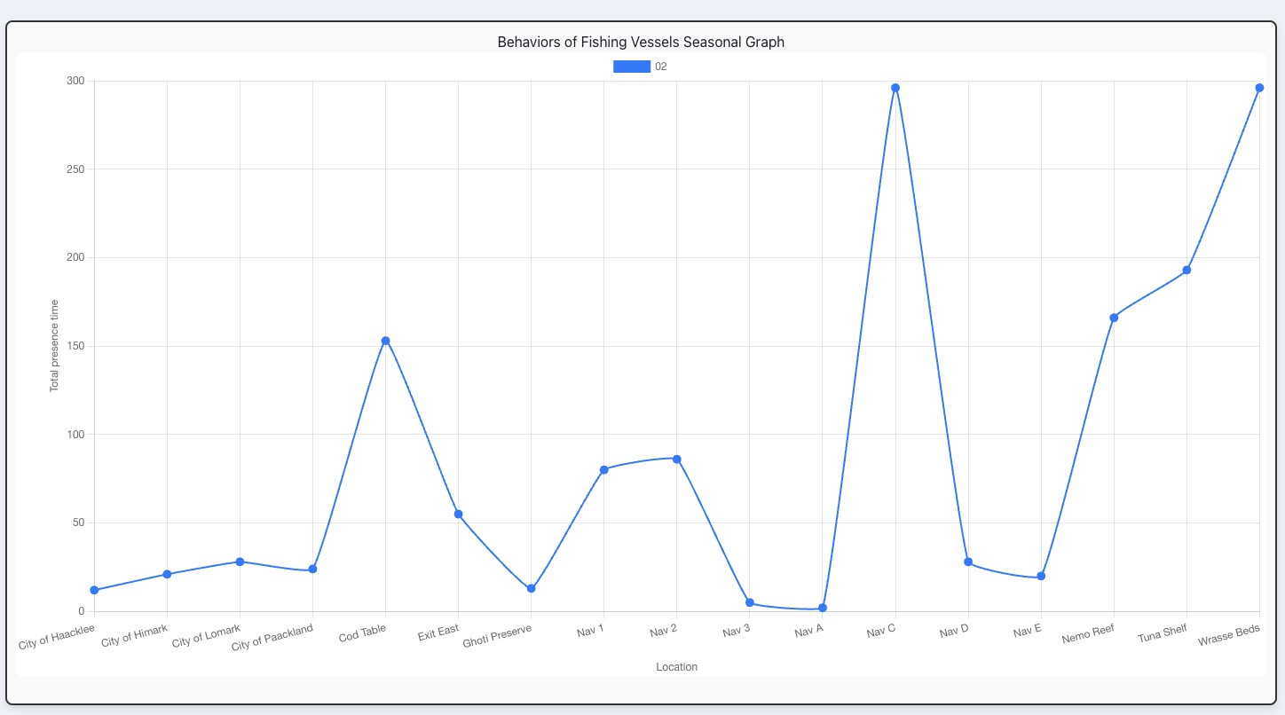
Line Graph
Goal: To show the general behavior of ships over monthly periods

Slide 9
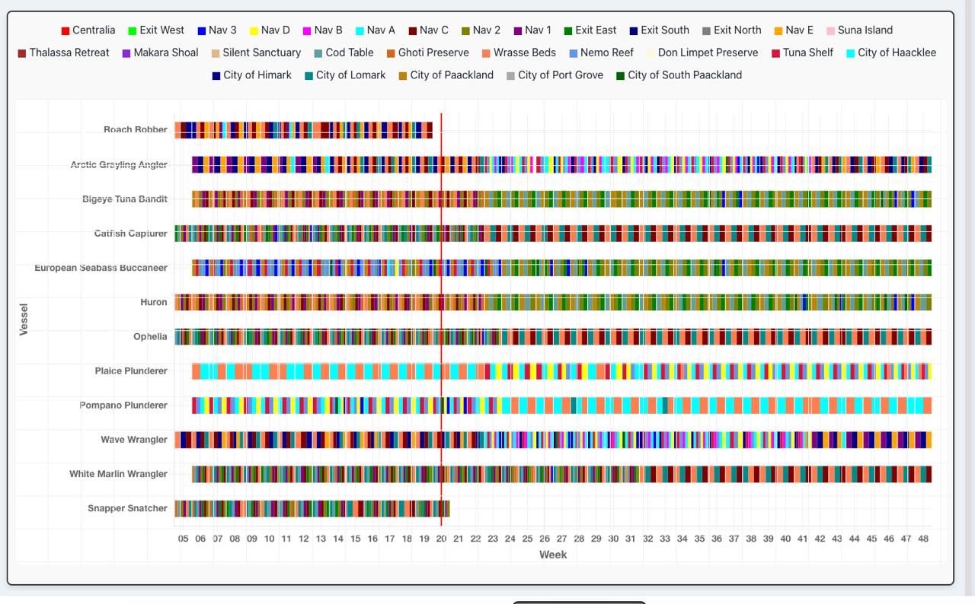

Slide 10
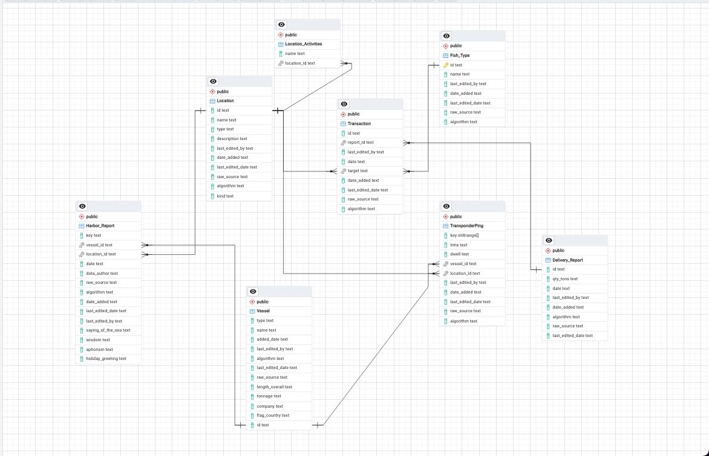

Slide 11
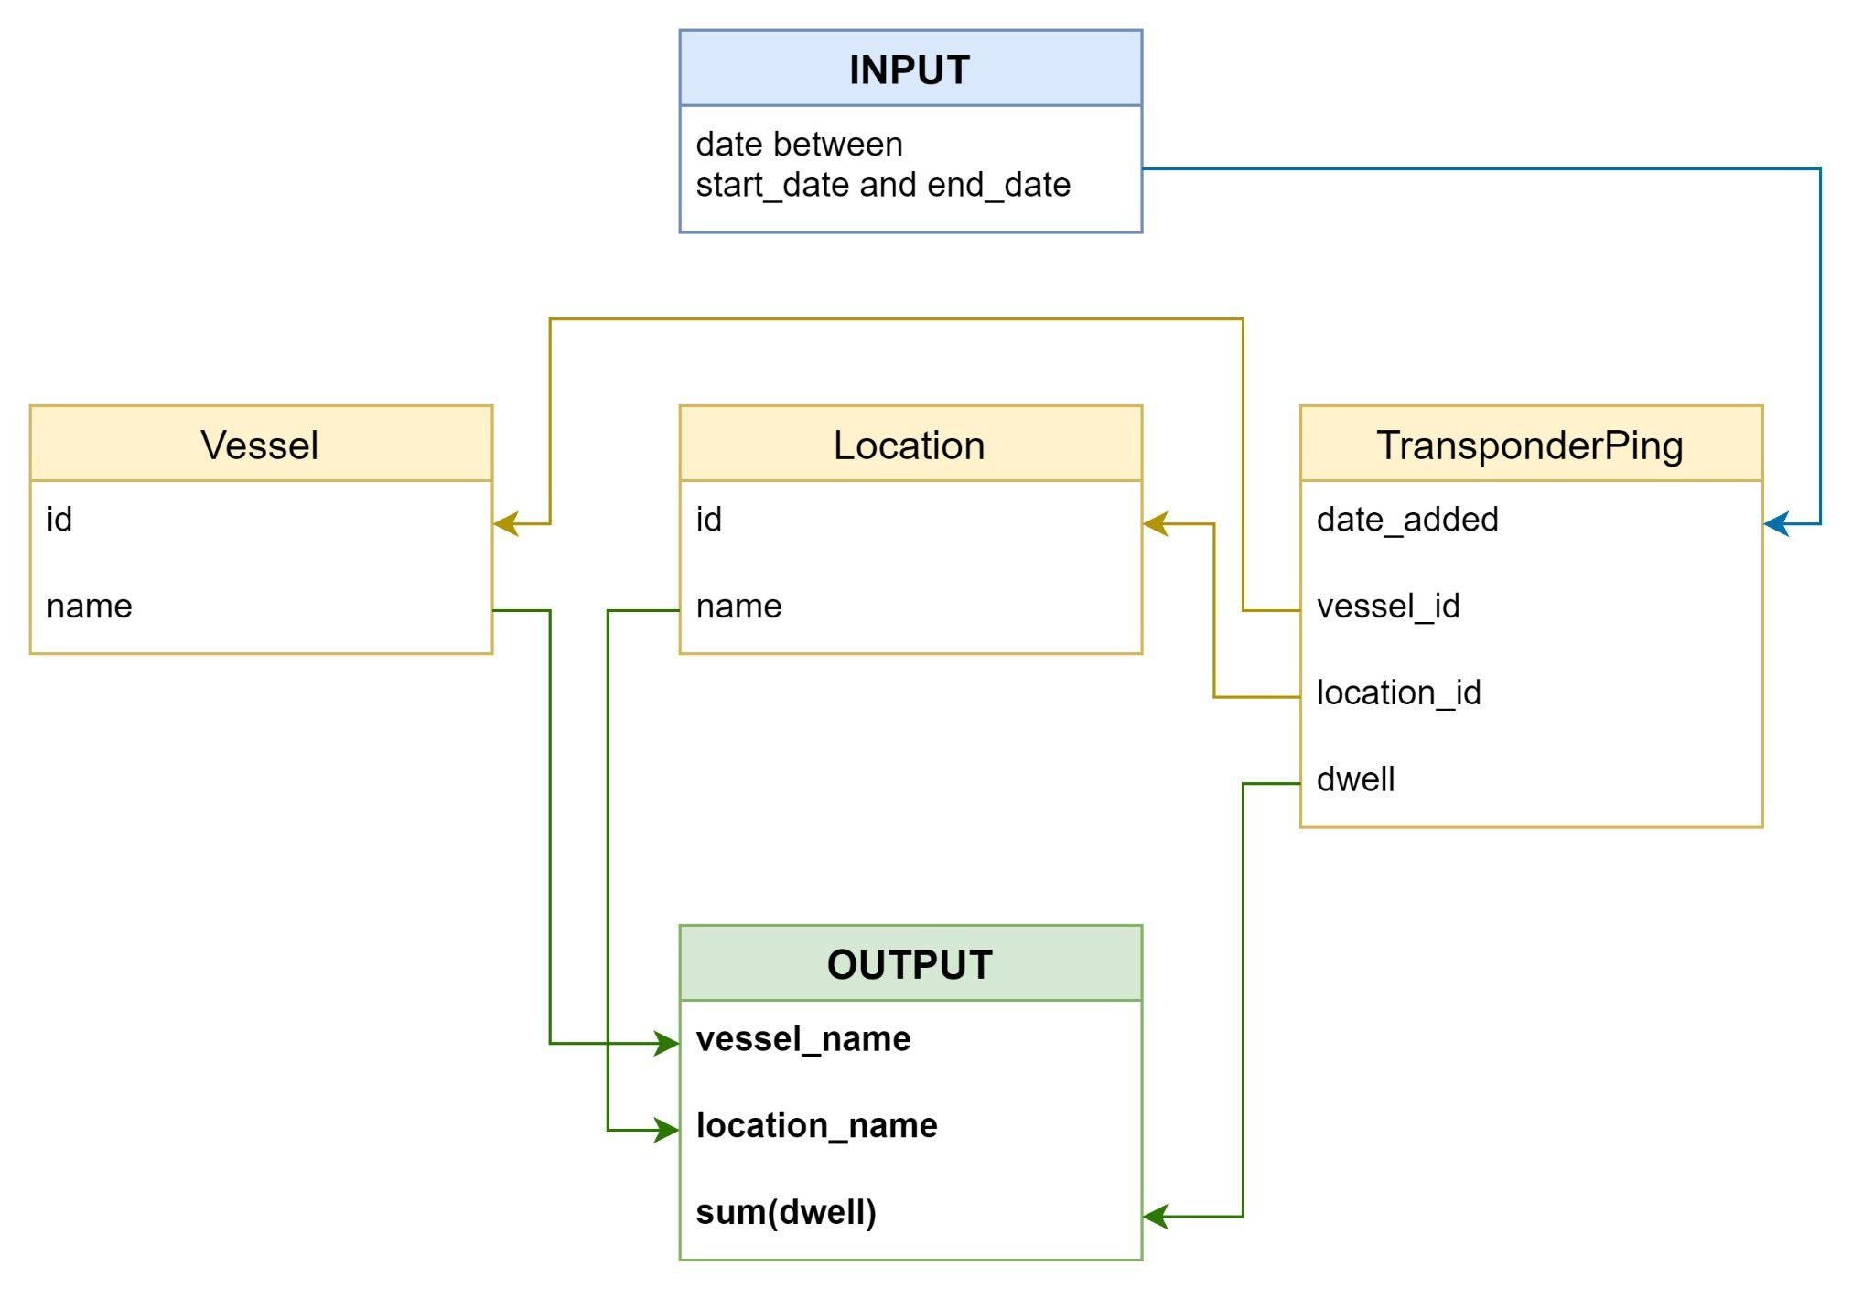
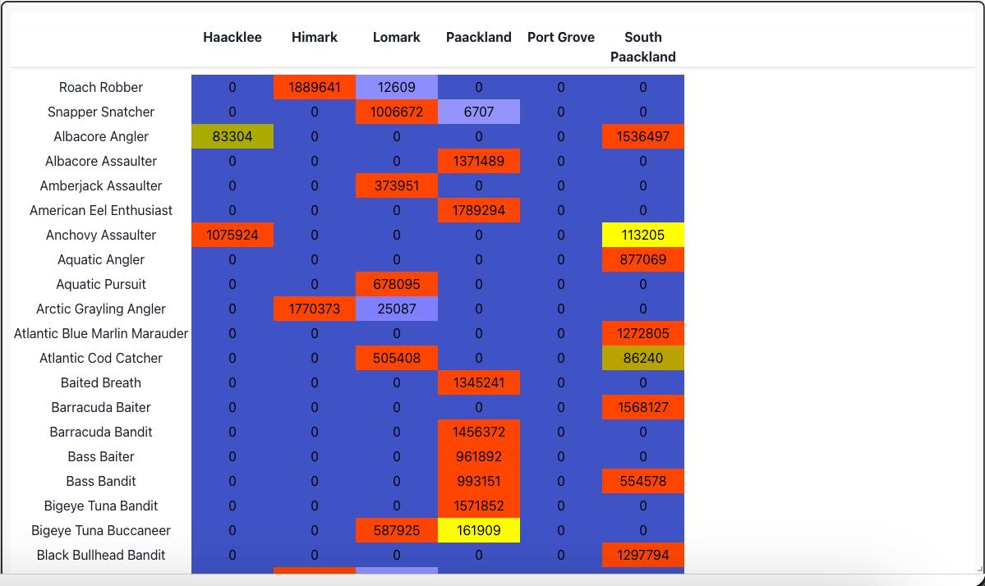

Slide 12
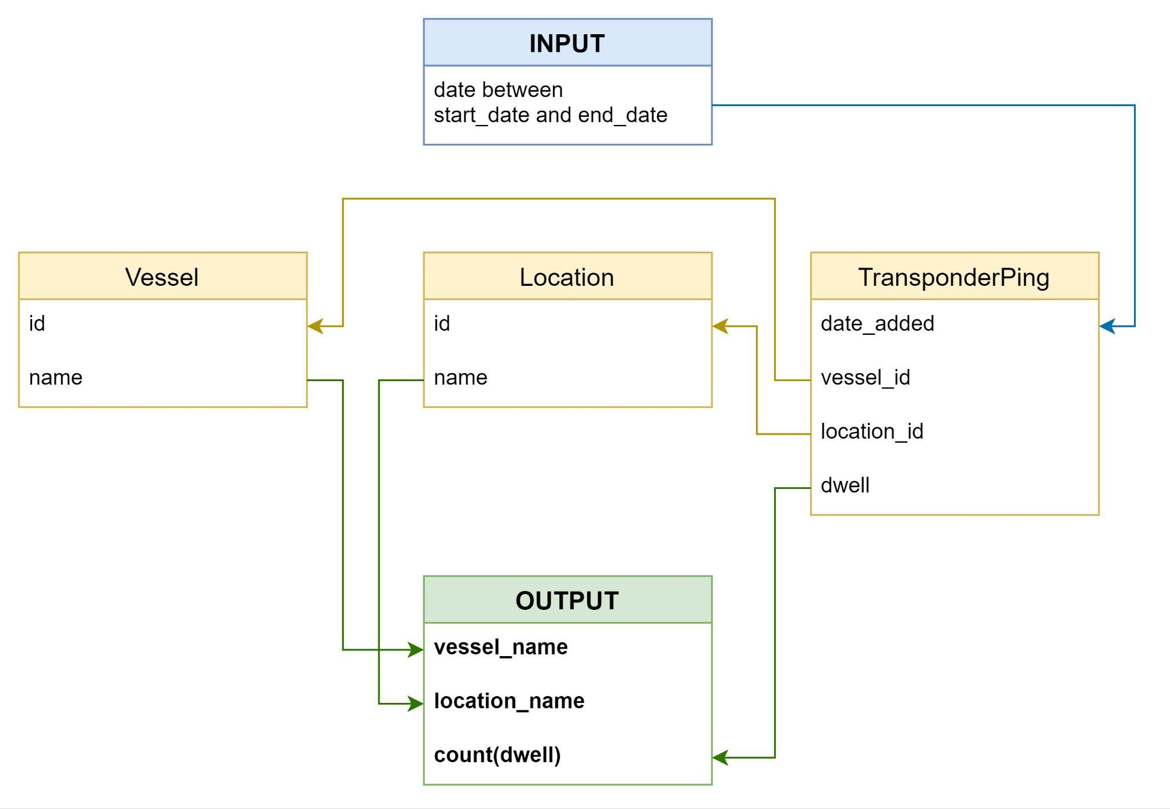
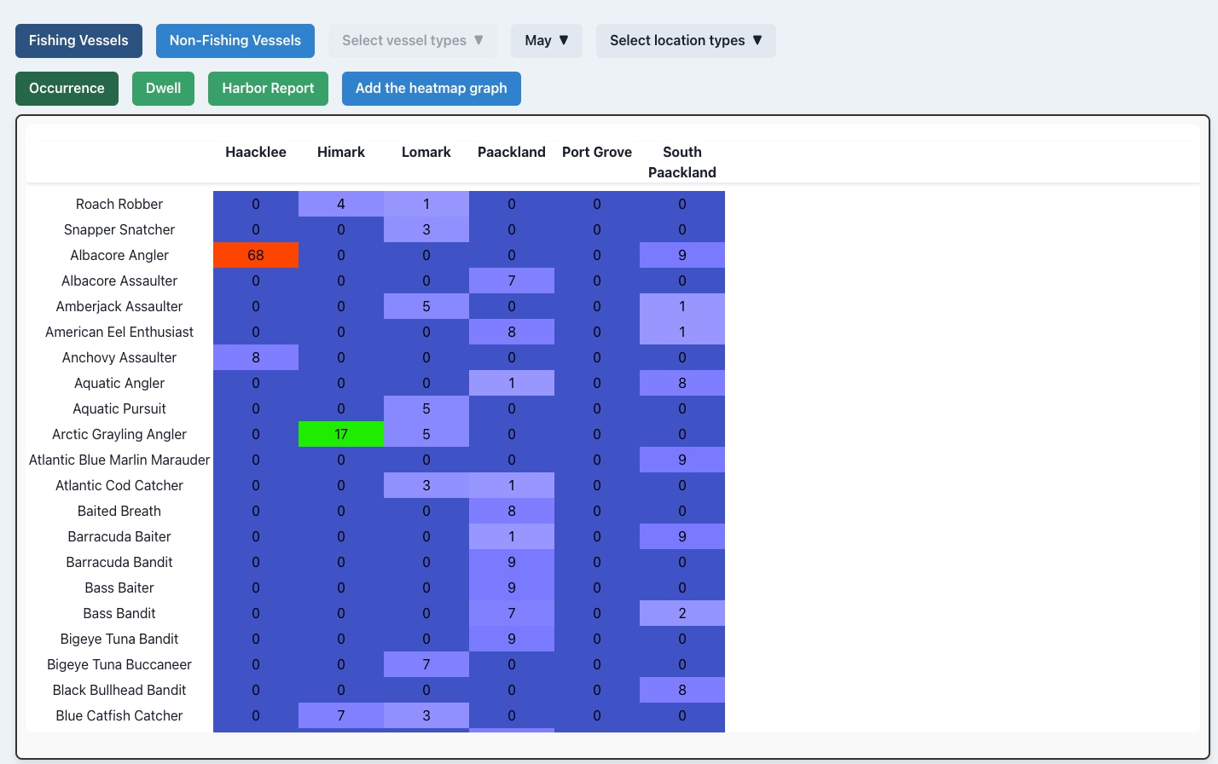

Slide 13
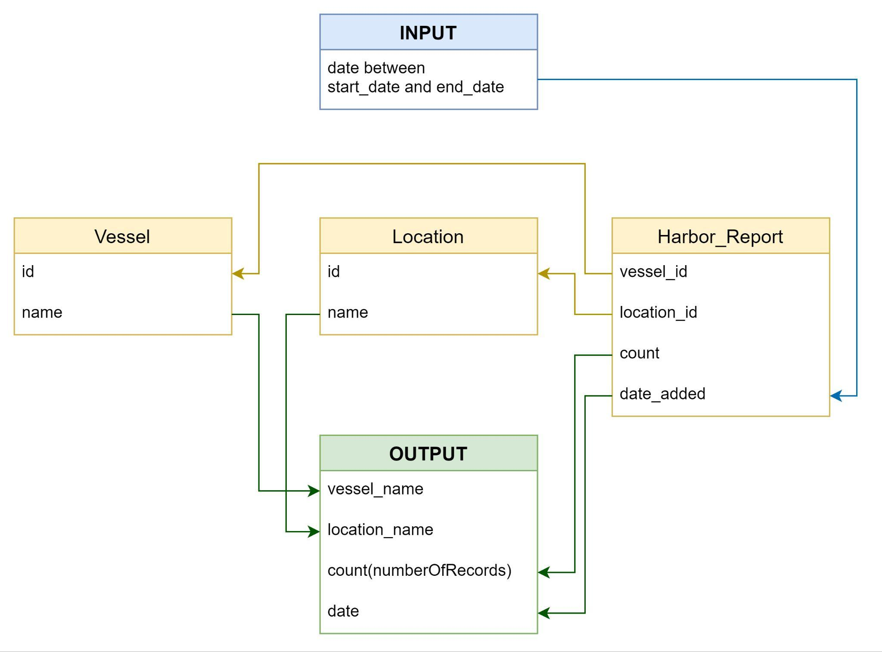
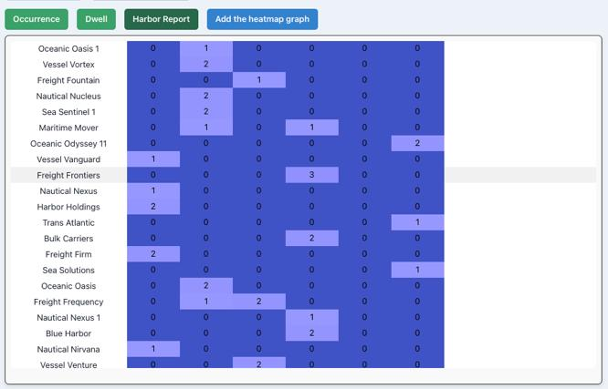

Slide 14
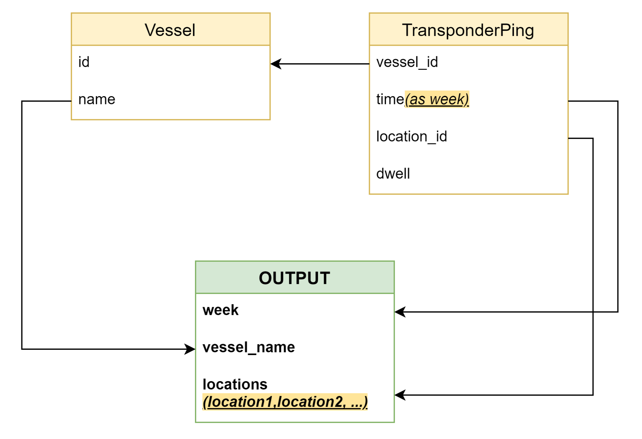

Slide 15
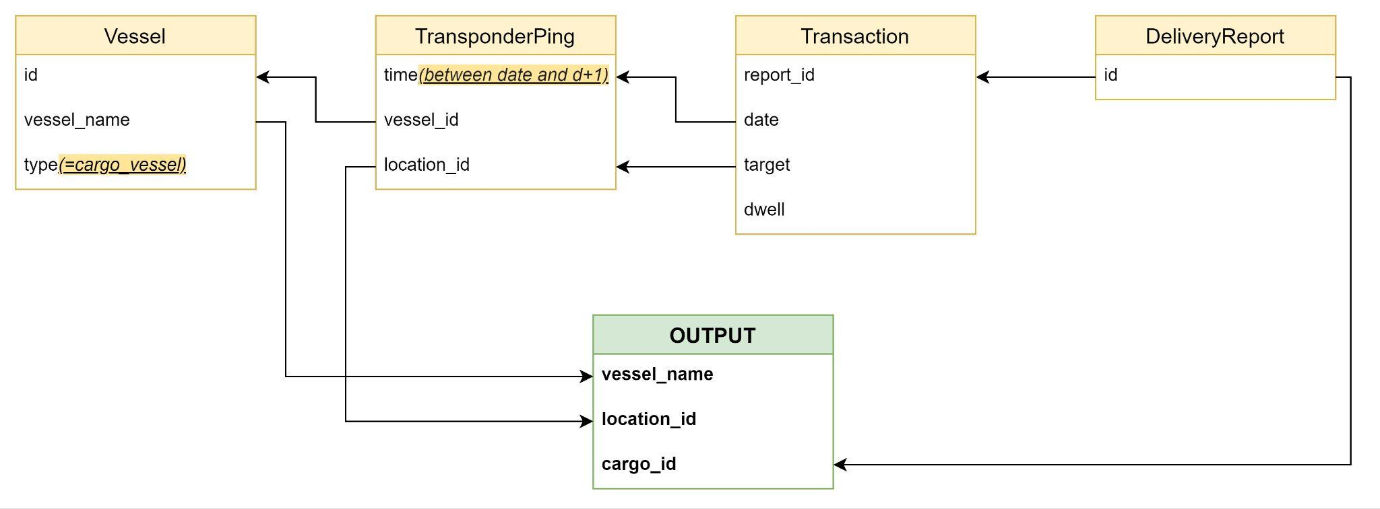
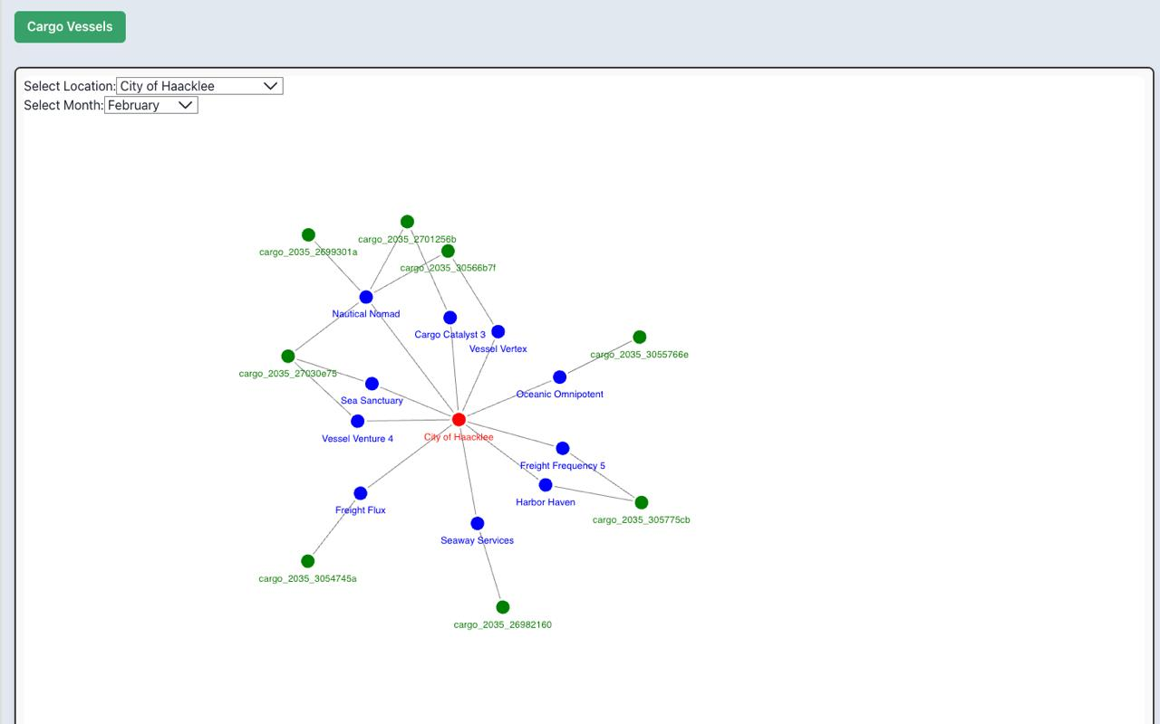

Slide 16
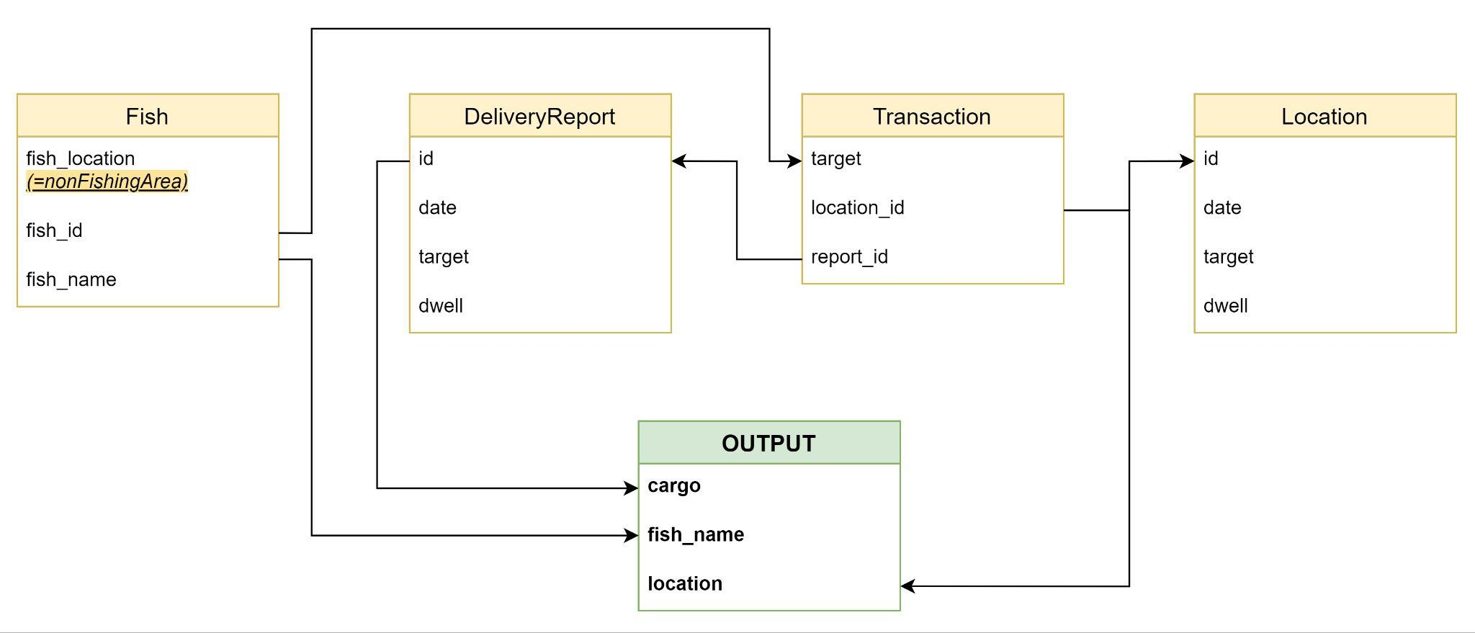
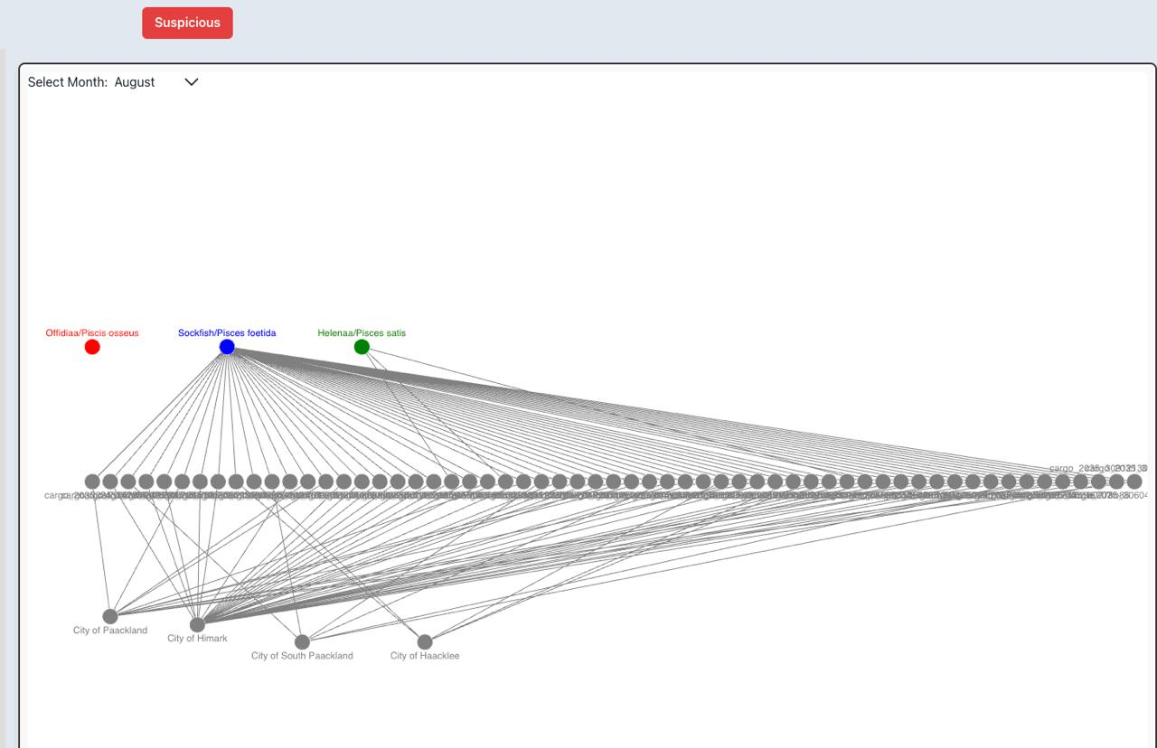

Slide 17
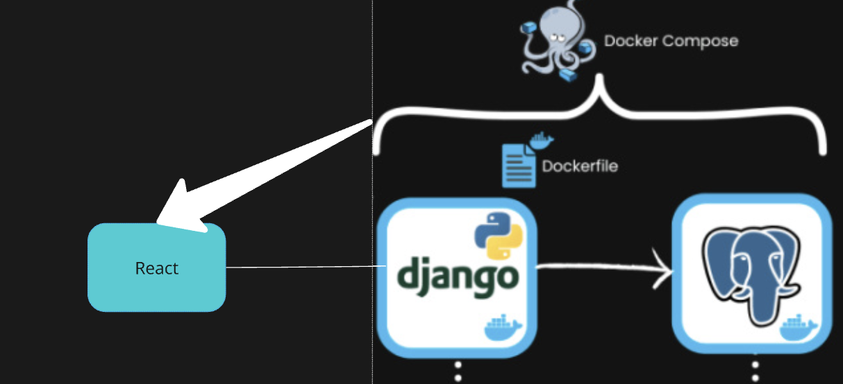
Tool Examination
Now we are going to answer each one of the main challenges with our visualization tool.

